Slide 1








IHE-HL7 Gemini MDI SDPi+FHIR – Project Update
for
Joint IEEE / HL7 / IHE Working Group Meetings
2021.05.26
FHIR is a trademark of Health Level 7, International.
SDC is a registered trademark of OR.NET

Slide 2
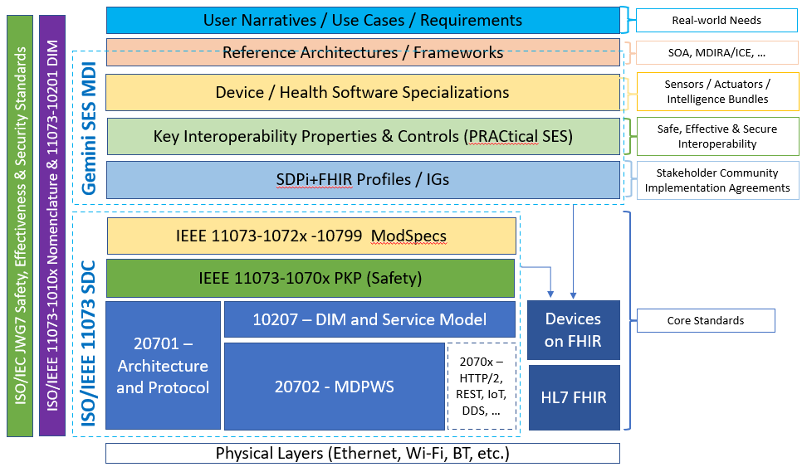
Gemini SES MDI using SDPi+FHIR
Project progress since January ’21 – Overview
Confluence Tours – Review of Recently Created / Updated Content
Program Planning & Outlook for remainder of 2021

Slide 3
Gemini SES MDI / SDPi+FHIR – Year 3 Progress – January to May
What have been the primary activity threads since the January 2021 working group meetings? [Are we there yet … are we there yet …]

Slide 4
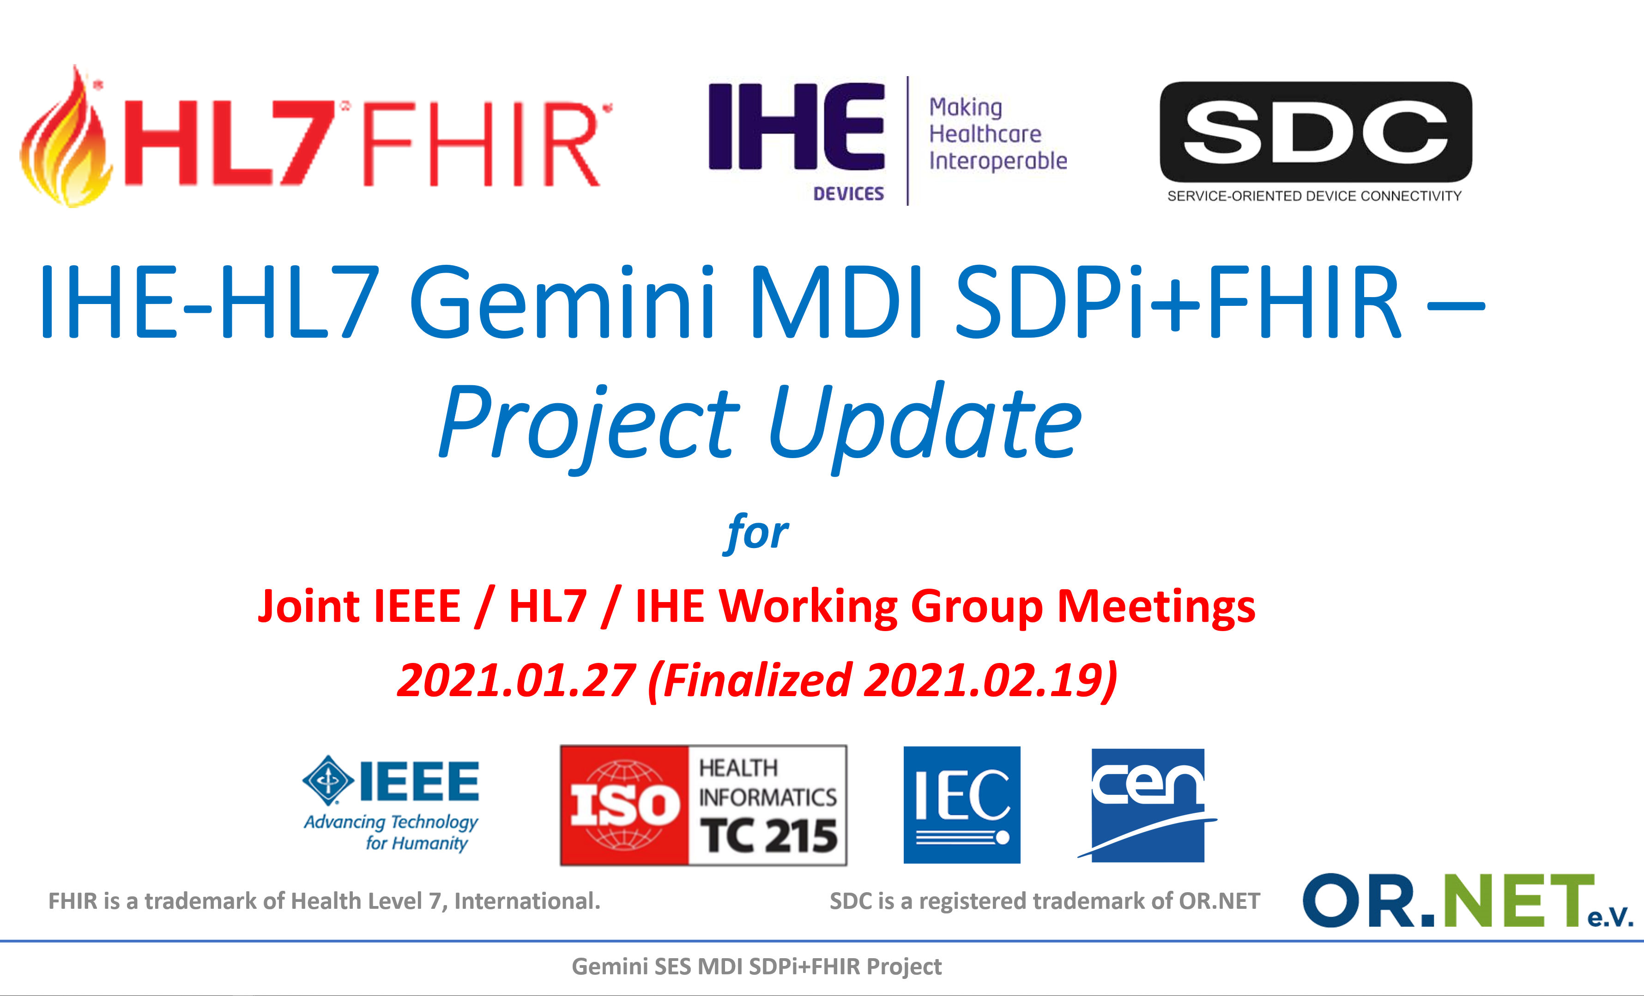
Gemini SDPi+FHIR – 2021.01 Update: Progress?
See January ‘21 Update for Year 1 & 2 Recap & Year 3 Planning (https://bit.ly/3oM3yaa or https://confluence.hl7.org/x/Xzf9Aw)

Slide 5
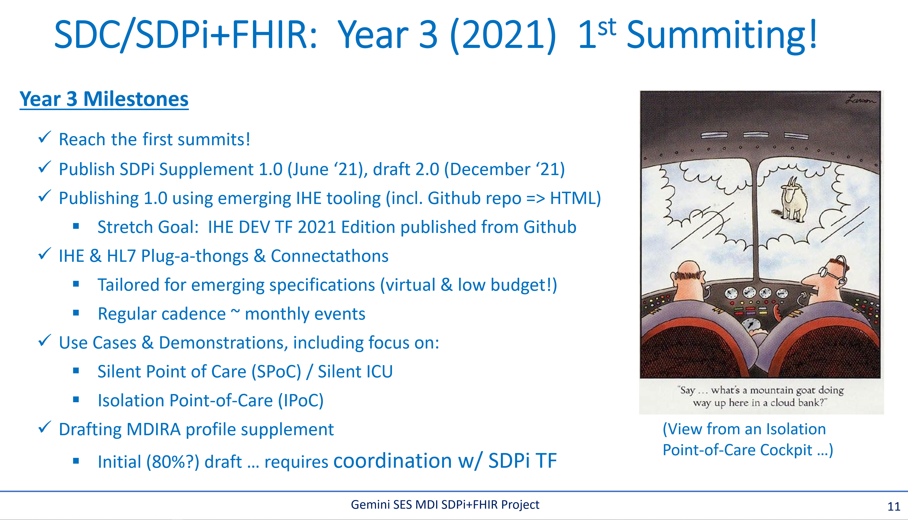
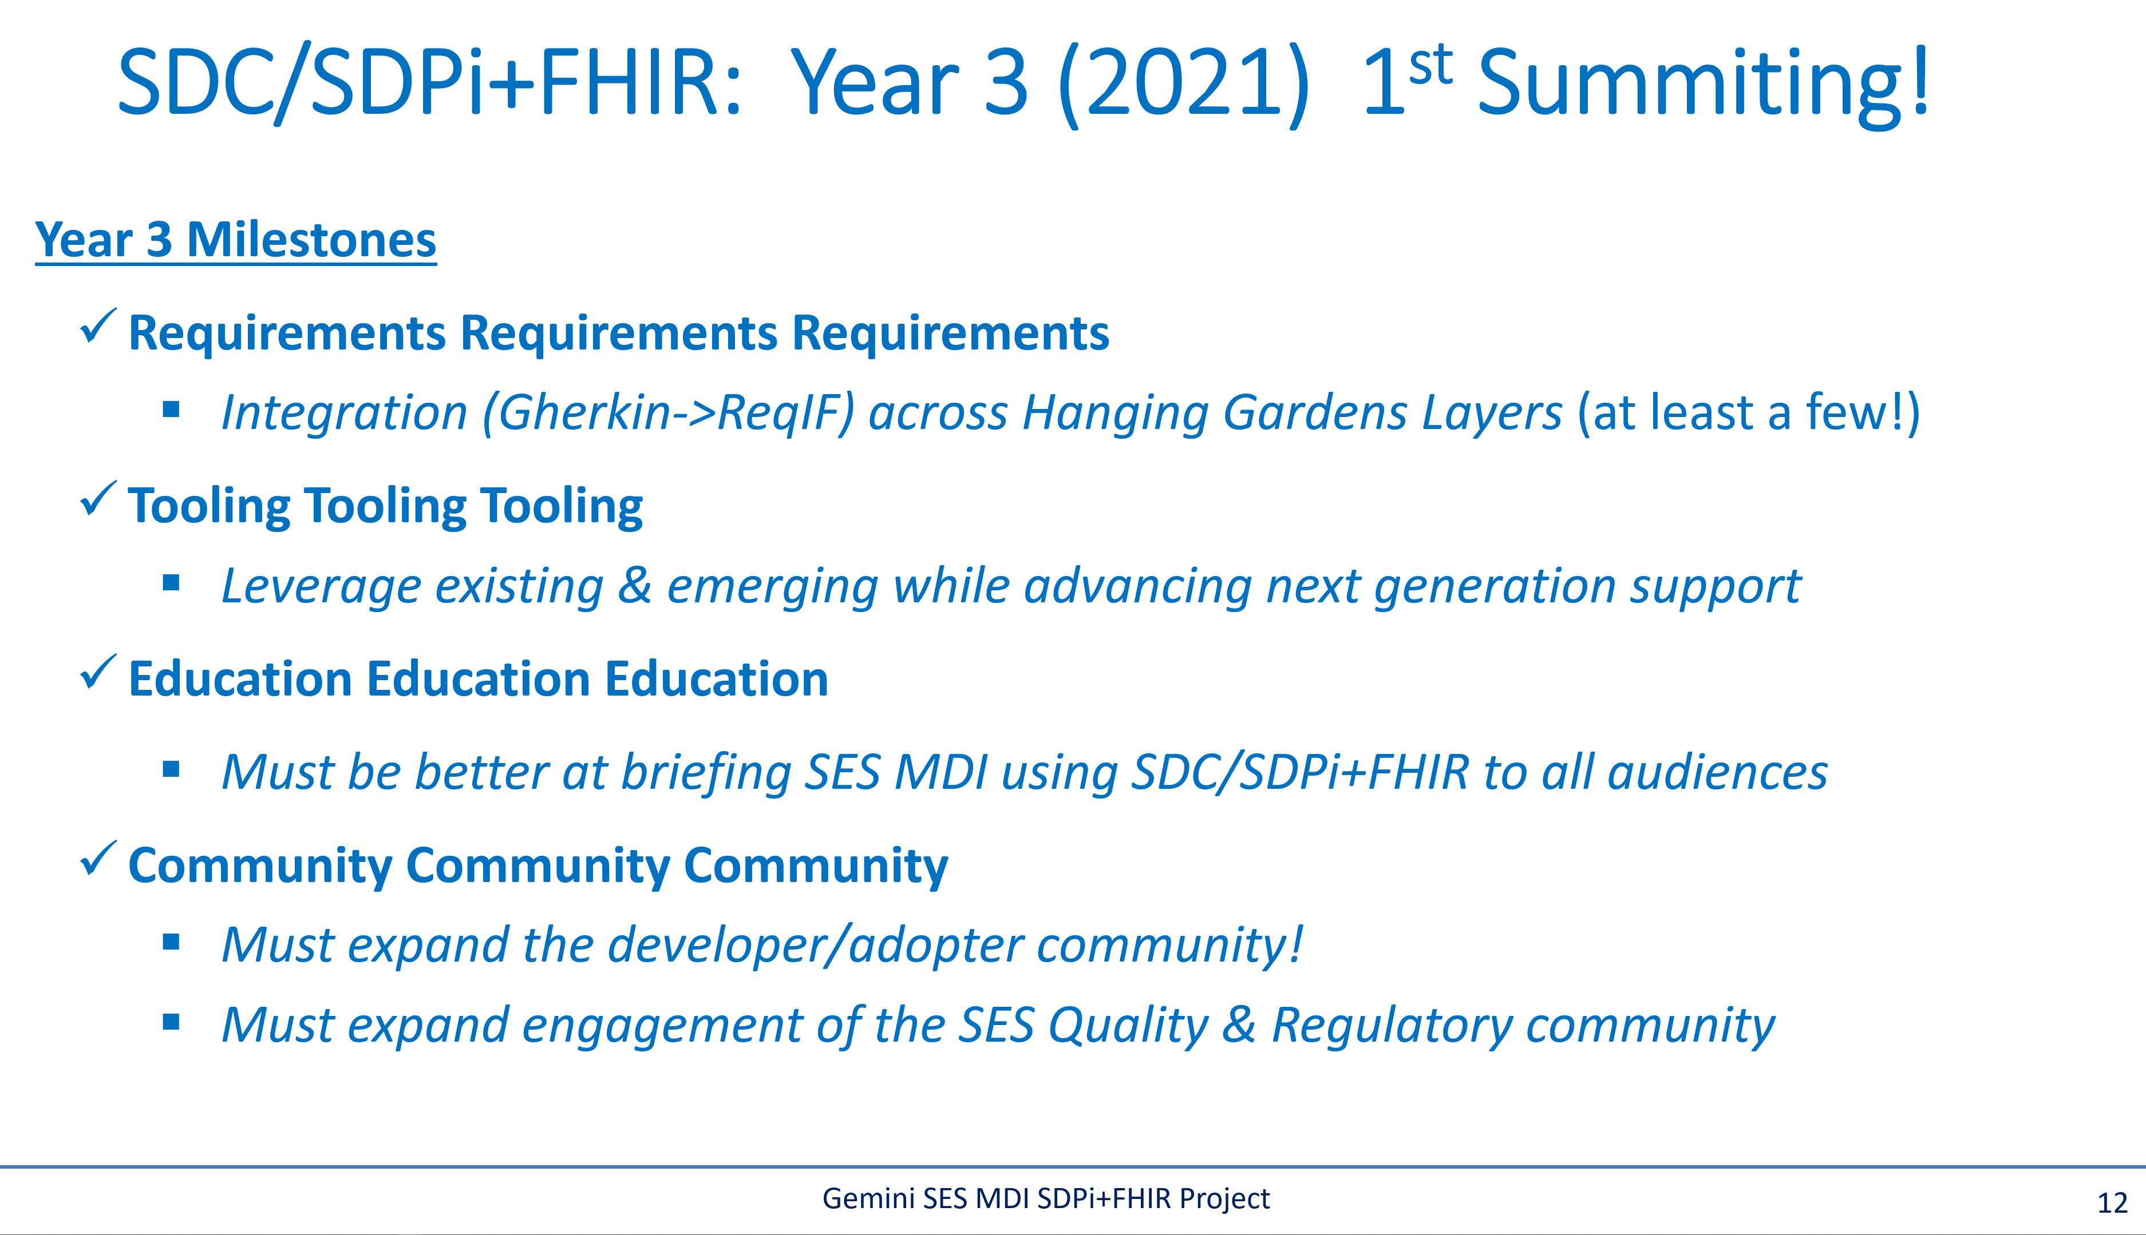
Gemini SDPi+FHIR – 2021.01 Update: Progress?
See “Confluence Tours” for specific progress details

Slide 6
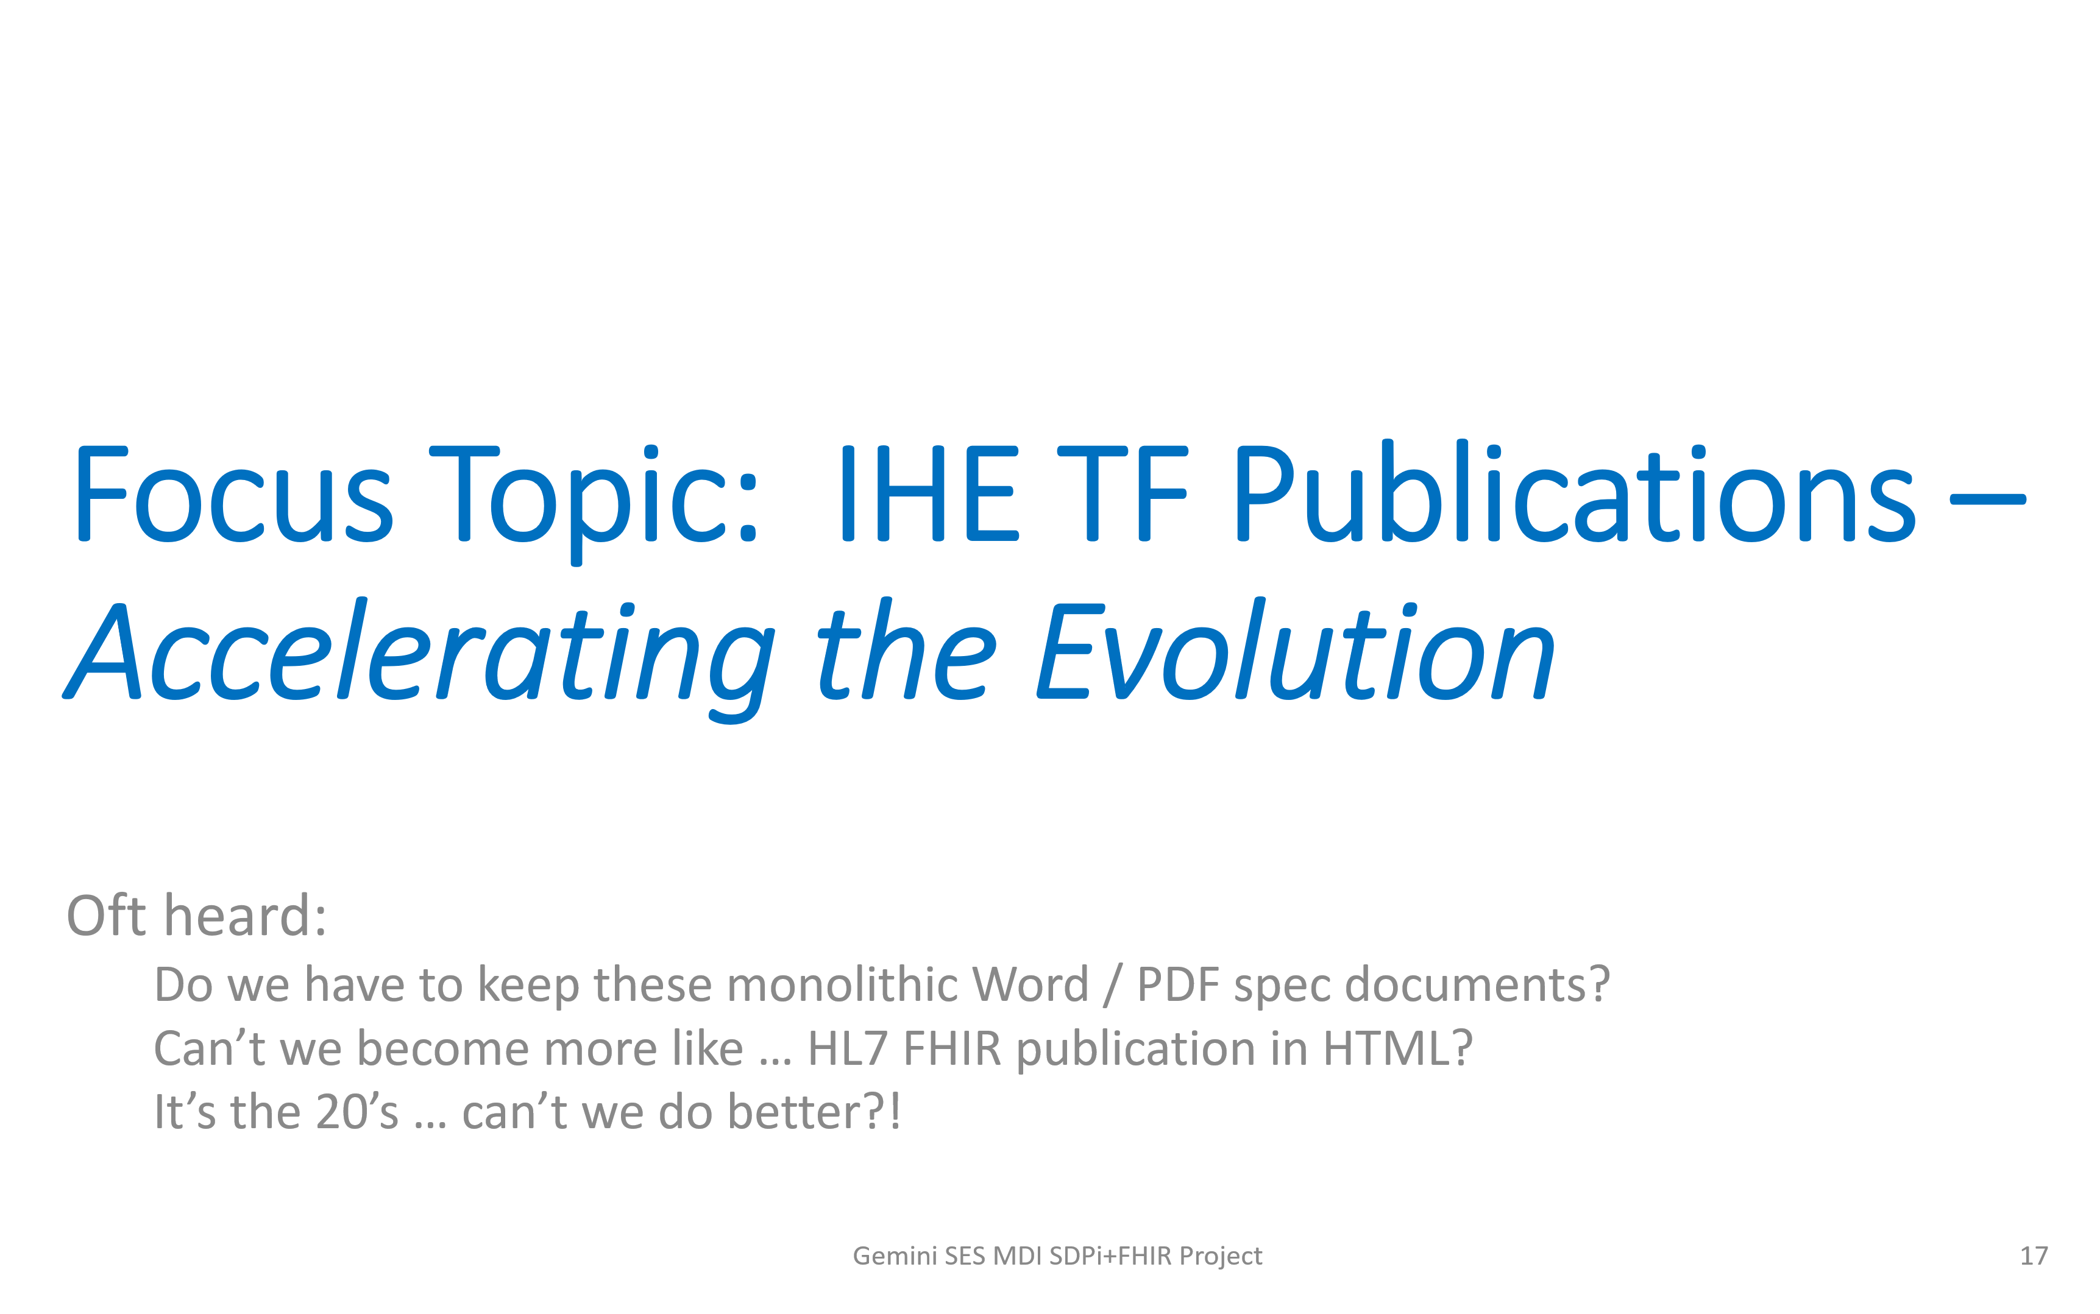
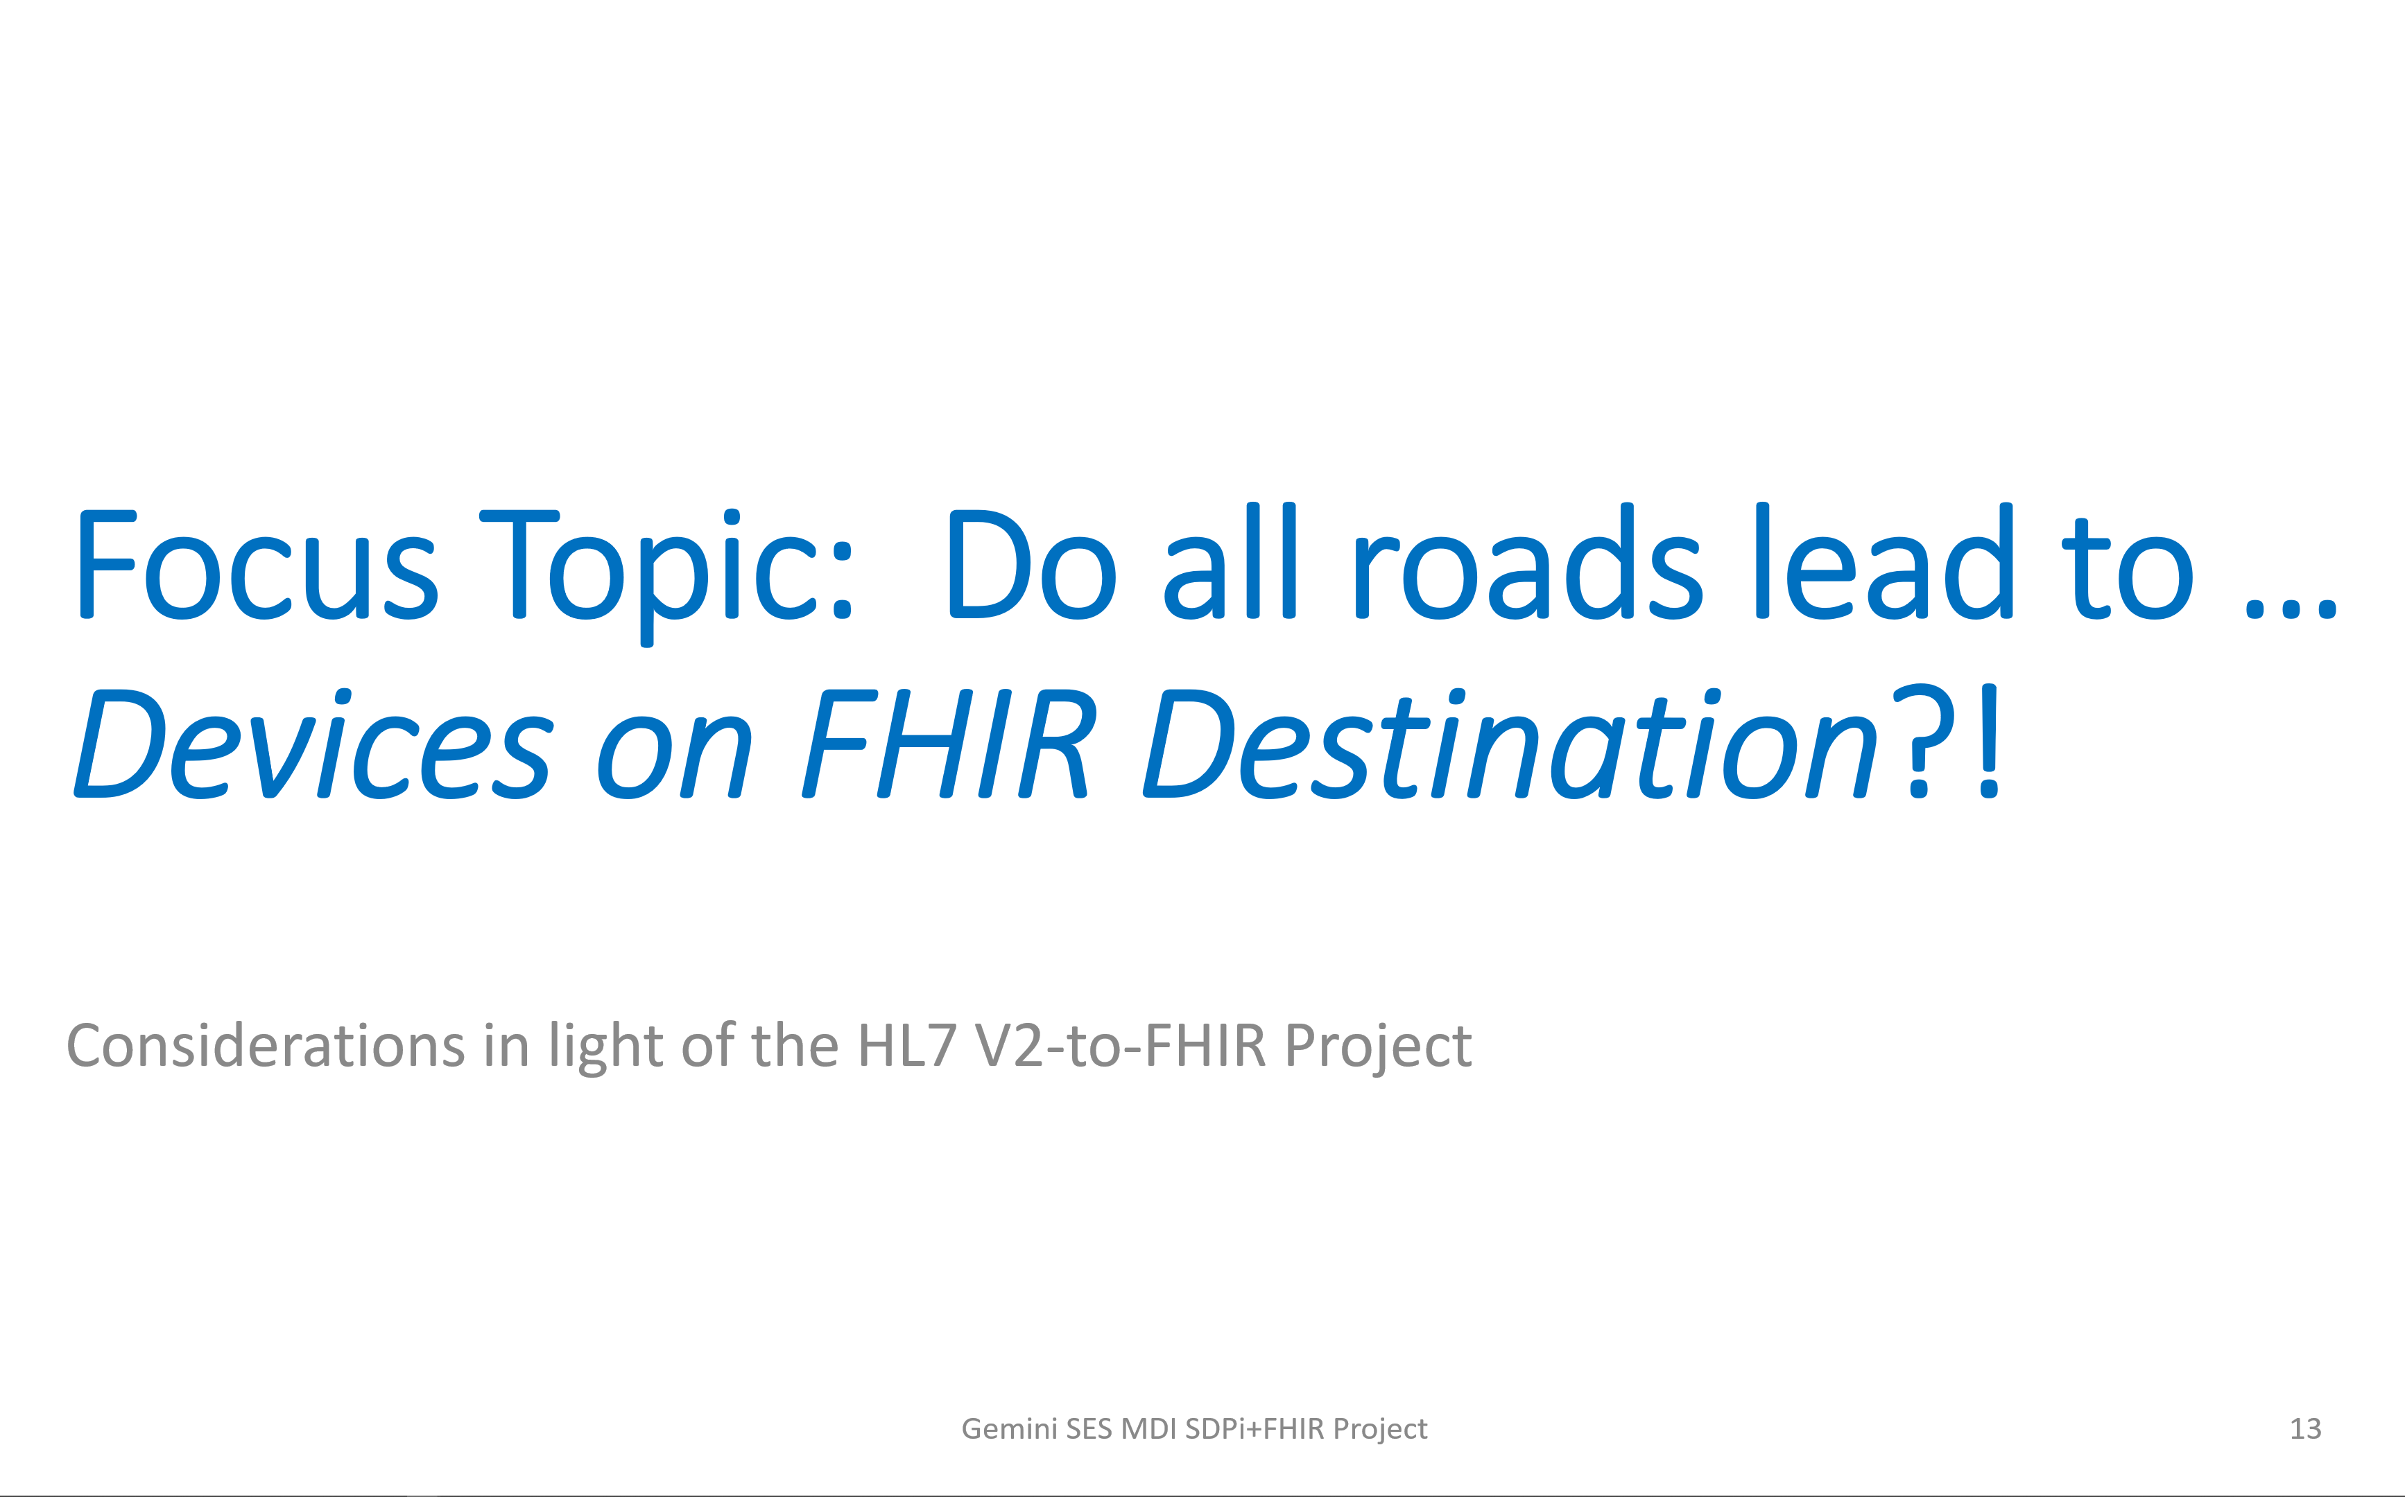
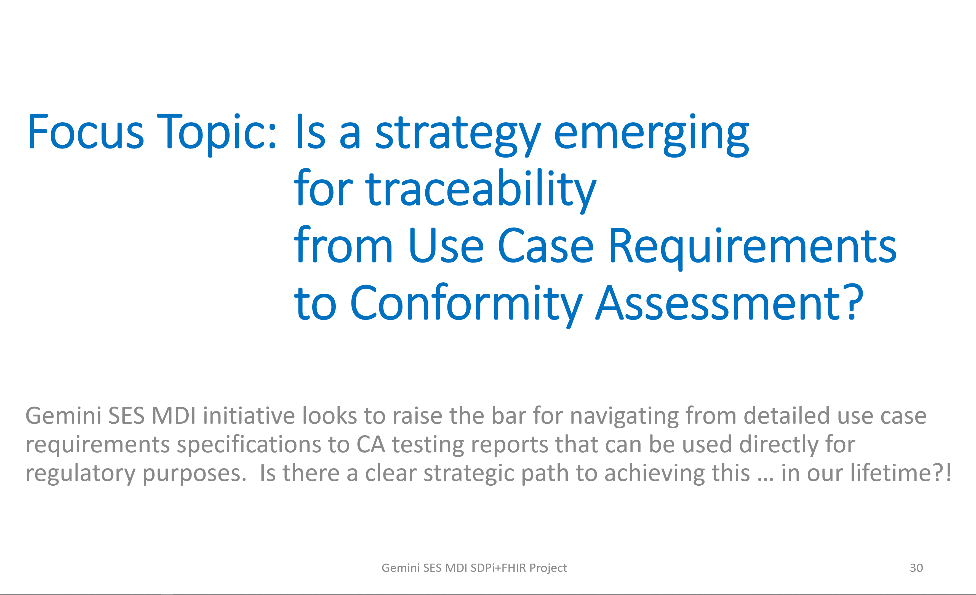
Gemini SDPi+FHIR – 2021.01 Update: Progress?
Now: RI-TF-CA
Now: Monitoring … kinda …

Slide 7
Confluence Tours: Review of Recently Created / Updated SDPi+FHIR Content
Guided journey through the Gemini SDPi+FHIR confluence pages focusing on the major destinations … while watching out for the “Under Construction” stretches along the way …

Slide 8
Gemini SDPi-FHIR Confluence Tours …
RI-TF-CA Coordinated Focus (https://confluence.hl7.org/x/KA7xB)
All work-in-progress … contribute!
MBSE / SysML / Cameo Pilot (https://confluence.hl7.org/x/YAZxBg)
FDA ASCA & IHE CA Pilot (https://confluence.hl7.org/x/VouHBg)
Requirements Interoperability Pilot (… https://confluence.hl7.org/x/oJGHBg)
Topics of Interest continue to expand (https://confluence.hl7.org/x/0yPxB)
“Watch” any confluence page for updates!
Device Specializations home (https://confluence.hl7.org/x/wZqfBg)
IHE SDC/SDPi PAT events (https://confluence.hl7.org/x/09R7BQ)
HL7 FHIR CAT “Isolation PoC” events (https://confluence.hl7.org/x/m2PPBQ)
MDIRA Profile home (https://confluence.hl7.org/x/4Y_HBg)
Education Pages (https://confluence.hl7.org/x/aojGBg)

Slide 9
Program Planning & Outlook for remainder of 2021
As we near the midpoint of 2021, what will be the focus for the 2nd half of the year and into 2022?

Slide 10
Gemini SDPi+FHIR: Planning 2021 & Beyond
3-5 Year strategic planning to be updated by end June ‘21 (see https://confluence.hl7.org/x/PA3PBQ)
Work streams & objectives same as identified in January ‘21 Update
General goals remain (though timeline may be tweaked):
Publish SDPi Supplement 1.0 by end Q3 ‘21
Virtual CAT by end ’21
2+ CATs in ‘22
HIMSS’22 Showcase Demonstration
SDPi Supplement 2.0 Q2 ‘22
SDPi PAT/FHIR CAT events every 1-2 months
Join Gemini SDPi+FHIR Community to keep up-to-date (https://confluence.hl7.org/x/JQ7xB)

Slide 11
IHE-HL7 Gemini MDI SDPi+FHIR – Project Update
for
Joint IEEE / HL7 / IHE Working Group Meetings
2021.05.26
“Watch” the project from it’s HL7 Confluence home:
https://confluence.hl7.org/x/Xzf9Aw
FHIR is a trademark of Health Level 7, International.
SDC is a registered trademark of OR.NET

